Slide 1
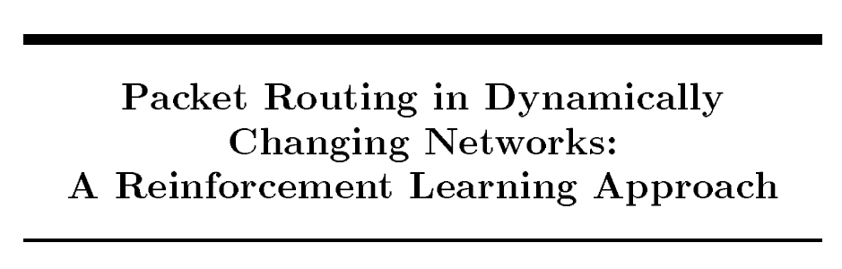
Pinyarash Pinyoanuntapong
[1] Boyan, Justin A., and Michael L. Littman. "Packet routing in dynamically changing networks: A reinforcement learning approach." Advances in neural information processing systems. 1994.
Notes:
Today, I am going to talk about Packet Routing in Dynamically Changing Networks with A Reinforcement Learning Approach by Boyan …. Published in 1994

Slide 2
Introduction
Objective:
Adaptive routing in high loads
Method:
Reinforcement Learning
Q-Learning
Notes:
Basically, this paper proposed a new routing alg, which uses Q-learning to find the best routing path.
It tries to learn a routing policy which balances miniming the number of hops a packet will take with the possibility of conestion along popular route. It des this by experimenting with different routing policies and collect the statistics which decision minimize total delivery time.

Slide 3
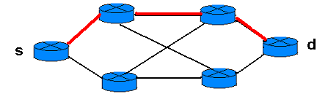
Challenges
Non-adaptive Routing Algorithm (Shortest path) routing table never change once initial routes have been selected unless there is a route failure.
The network topology could be dynamically changed (Wireless Mesh Network)
High network loads
Notes:
A goal of routing alg is to find the best routing path and route the data in the most efficient way.
They used q-learning to do routing because there are some challenges in the conventional routing alg.
The most well-known routing alg is Shortestpath.
A definition of the routing problem: optimally routing packets on a dynamically changing network with unpredictable usage patterns.
The Routing Problem
mainly use hop counts to select paths.
This does not meet the requirements of many emerging communication applications.
For example, live multimedia applications must make sure that
-Packet delays are bounded.
-Jitters (changes in packet delays) are well controlled.

Slide 4
Motivation
The Q-routing was introduced to confront those problems.
Q-routing is a self-adjusting algorithm for packet routing
Optimally under high loads, network adaptively
Notes:
2.Q-routing is a self-adjusting algorithm … which can handle the dynamic topology
3.It can find the optimal path when there is a high loads in the network.
Topologies changes, as nodes are added and removed
Traffic patterns change cyclically
Overall network load changes

Slide 5
Overview of Q-routing
Goal: Learning routing policy to avoid congestion along popular paths
A reinforcement learning “module” is embedded into each node/router.
Only uses local communication between neighbors to keep accurate estimates about the network at each node.
The estimates are maintained in each node in a lookup table Q.
The final routing policy equals to the collection of all local decisions made by individual nodes (based on their Q table).
Notes:
Learns a routing policy, which minimizing total time delay.
Each node estimates T of their neighbor node by deploy RL module to every router
Only uses local… more like dynamic computing
Q-learning is applied to the routing problem in Q-Routing algorithm, where routing table in the distance vector algorithm [7] is replaced by the table of estimations (Q values) based on the link delay
i

Slide 6
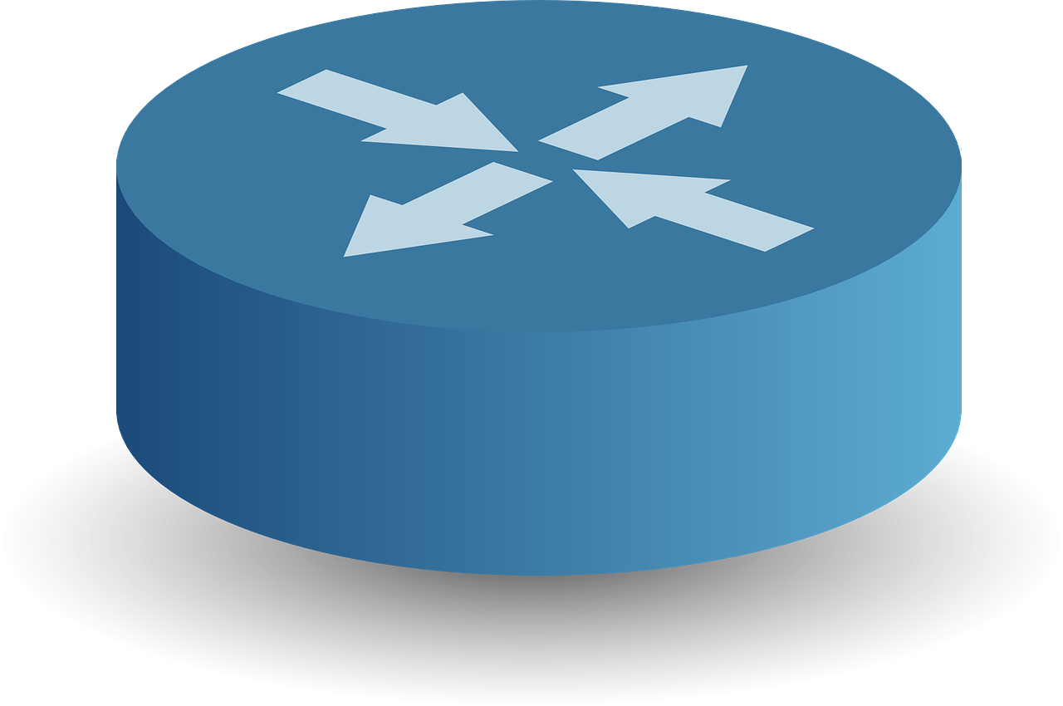
Q-Routing: Notation
Q_{x}(y,d)----estimated time that a packet would take to reach the destination node d from current node x via x’s neighbor node y
T_{y}(d) ------y’s estimate for the time remaining in the trip to d
q_{y} ---------queuing time in node y
T_{xy} --------transmission time between x and y
q_{y}
T_{xy}
y
T_{y}(d)
New estimate
old estimate
Q_{x}(y,d)
x
d
Learning rate
Notes:
Q-routing represents the Q-function as Qx() try to estimate the time delay of a packet sends from X to D via neighbor node y
Ty(d): Node try to estimate the time remain in the trp to d

Slide 7
Time-delay
Queuing: q_{y} queuing time in node y
Time waiting at output link for transmission
Depends on congestion level of router
T_{xy} transmission time between x and y
R=Link bandwidth (bit/s)
L=Packet length (bits)
Time to send bits into link(T_{xy}) = L/R
Notes:
There are two important parameters in this equation.
First Qy

Slide 8

Algorithm of Q-Routing
Set initial Q-values for each node
Get the first packet from the packet queue of node x
Choose the best neighbor node and forward the packet to node by
Get the estimated value from node
Update
Go to 2.
q_{y}
T_{xy}
y
T_{y}(d)
Q_{x}(y,d)
x
d
Set
Q-values
Observe
Neighbors nodes
Action:
Choose
Best neighbor
Reward
Time-delay
Update
Q-table
Notes:
First, set the Q-values of each node
For example, there is coming flow to node X.
2. Node X get the first packet from packet queue and observes time-delay of the neighbour nodes
3. The action is to choose the best neighbour, which has the smallest time delay from Q-table.
When a node x sends a packet to node d via its neighbour y, it gets back y’s estimated remaining trip times to the destination d, selects
the neighbour with the smallest delivery time
.
After receiving the packet, the router y provides x an estimate of its best Q value to reach the destination.
The new information is added in the Q-values of the router x.
The rule for updating the router x Q-values are:

Slide 9
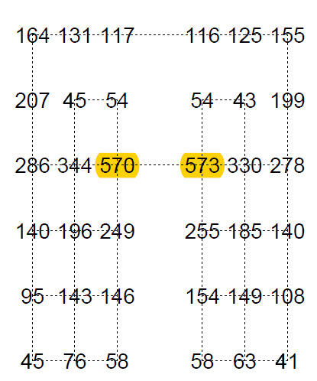
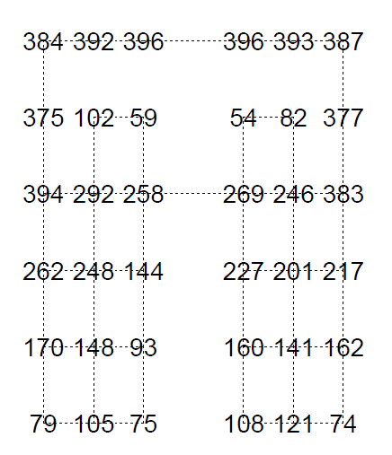
Shortest path
Result
Q-routing
showing for each routing policy, how many routing paths go trough each node
Notes:
Topology changes: Connecting and disconnecting nodes from the grid. Q-routing reacted fast to this changes and was able to continue efficiently.
Traffic patterns: Oscillating between 2 patterns that the traffic is directed by (North-South, East-West). Q-routing adapted successfully to each change of directions after a period of adaptation.
Load Level: Under conditions of low network load the algorithm learns to route packets along shortest paths (as BF), after a period of inefficiency during which it explores the network (under low load the optimal policy is shortest paths since no queues exist at nodes).
As network load increases, shortest path routing scheme ceases to be optimal: it ignores the rising levels of congestion on some routers (found on bottlenecks) and floods the network through them. Q-routing adapted its policy to route its packets over new paths thus avoiding the congested bottleneck.

Slide 10
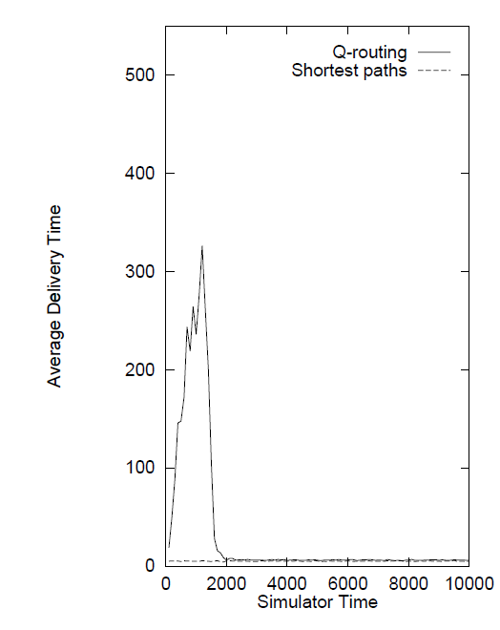
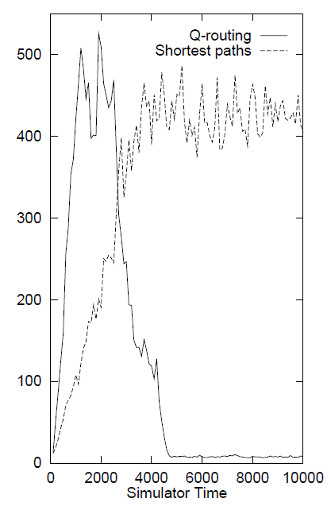
Results: Low load vs High load
Low load
High load
The shortest path alg. performs better than Q-routing under low load.
Q-learning performs better under high loads but it takes some time to learn.
Topology changes: Connecting and disconnecting nodes from the grid. Q-routing reacted fast to this changes and was able to continue efficiently.
Q-routing
Shortest Path
Q-routing
Notes:
As network load increases, shortest path routing scheme ceases to be optimal: it ignores the rising levels of congestion on some routers (found on bottlenecks) and floods the network through them. Q-routing adapted its policy to route its packets over new paths thus avoiding the congested bottleneck.
Load Level: Under conditions of low network load the algorithm learns to route packets along shortest paths (as BF), after a period of inefficiency during which it explores the network (under low load the optimal policy is shortest paths since no queues exist at nodes).

Slide 11
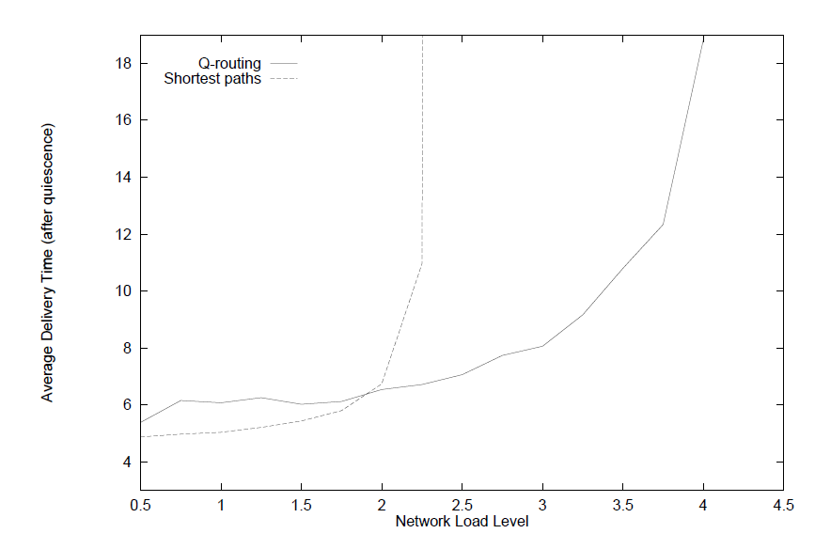
Result: Delivery time at various loads
Shortest Path
Q-routing
Notes:
When the load is very low, the q-routing perform very closed to Shortestpath, as the load increases, Shortest path become congested.
Wheeas the q-roputing learning allgorithms continues to route effienctly.

Slide 12
Conclusion
Pros
The learning is online and continual, using only local information.
Performs well under high loads
Dynamically topology, with out centralize controller.
Drawback
does not exploration no fine-tuning after the initially learning a viable policy
Failure to converge back to shortest paths when network load decreases again.
Failure to explore new shortcuts
Notes:
does not exploration no fine-tuning after the initially learning a viable policy since only best neighbor estimate is only updated
If the node learns an overestimate of the delivery time for an optimal route, then it will select suboptimal route
First, Q-routing is not always able to find the shortest paths under low network load. For example, if there exists a longer path which has a Q-value less than the (erroneous) estimate of the shortest path, a routing policy that acts as a minimum selector will not explore the shortest path and hence will not update its erroneous Q-value.
Second, it fails to adapt to the optimal (shortest) path again when the network load is lowered. Once a longer path is selected due to increase in network load, a minimum selector is no longer able to notice the subsequent decrease in traffic along the shortest path.
Q-routing continues to choose the same (longer) path unless it also becomes congested and has a Q-value greater than some other path. Unless Q-routing continues to explore, the shortest path cannot be chosen again even though the network load has returned to a very low level.
However, as mentioned in (Boyan & Littman, 1994), random exploration may have very negative effects on congestion, since packets sent along a suboptimal path tend to increase queue delays, slowing down all the packets passing through this path.

Slide 13
Reference
[1] Boyan, Justin A., and Michael L. Littman. "Packet routing in dynamically changing networks: A reinforcement learning approach." Advances in neural information processing systems. 1994.

Slide 14
Software-defined Intelligent Networking
Objective:
Apply the Q-routing to
the Software-Defined Wireless Mesh testbed.
Method:
Software-defined network (SDN)
Q-learning
Notes:
It tries to learn a routing policy which balances miniming the number of hops a packet will take with the possibility of conestion along popular route. It des this by experimenting with different routing policies and collect the statistics which decision minimize total delivery time.

Slide 15
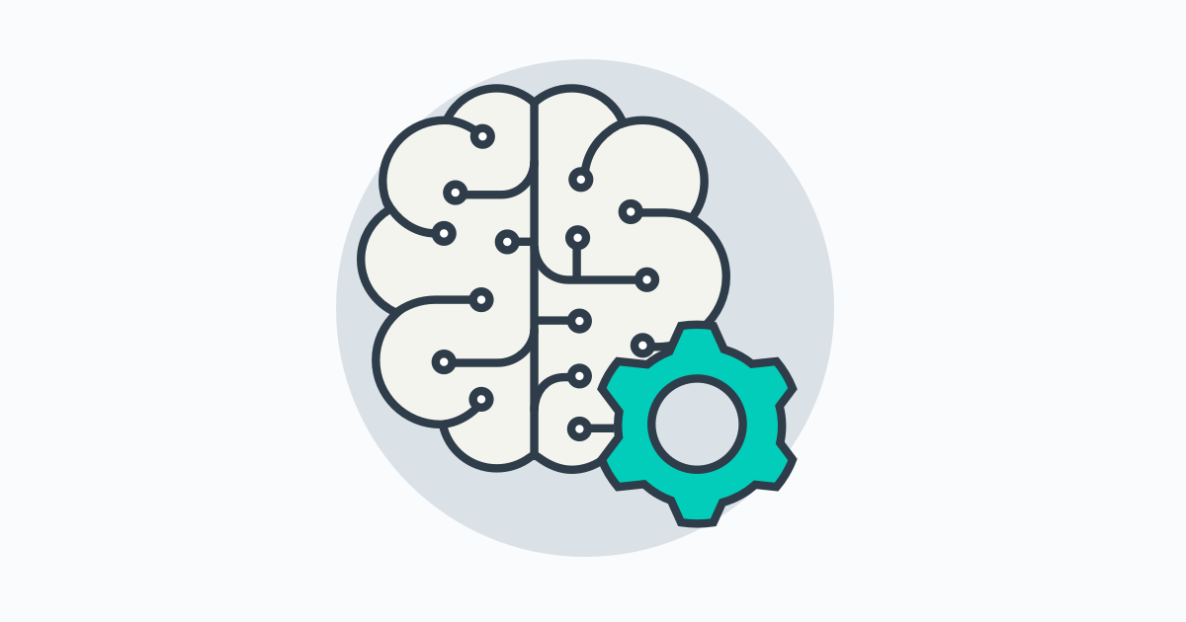
Centralize Control
Make a decision and install a flow from Controller
Q-routing
Knowledge
3
Each node update information to controller
Controller provides information (delays) to Q-routing App
Make a decision send command back to controller
Install a flow
2
Global view
Control
4
1
DATA

Slide 16
Distributed Agent
Make a decision and install a flow in local
Only update Information (Q-table) to controller
Run Q-routing App in every nodes locally
Estimate the time-delay of neighbors in local or get it from controller
Select & Install the flow with openflow rules
Update the Q-values to controller
Global view
Control
2
1
DATA

